Slide 1


Slide 2

Digital narrative –
modelling business processes with Camunda

Slide 3

1
Why should I care about BPMN?
Notes:
Chapter Intro Slide (version P)
This slide should be used at the beginning of each “chapter” of your presentation (as introduced in the Agenda slide) to keep the audience aware of their place in the story and to help break things up. Change the text and chapter number accordingly. If you do not need a sub-head (the smaller text), delete it. Use different backgrounds for different chapter titles, try not to repeat a background.
Very short presentations (< ~10 slides) may not need Chapter Intro Slides.
There are multiple versions of this template with various white and black background images starting on slide 10.

Slide 4
Digital narrative – modelling business processes with Camunda - 1. Why should I care about BPMN?
Business Process Model and Notation
1. SPECIFICATION
Global standard for process modelling that provides a graphical notation for specifying business processes in a Business Process Diagram, based on a flowcharting technique.
2. Simplicity
The principle behind BPMN is rather simple and can be understood by non-IT professionals. This minimizes the risk of misunderstandings between business analysts and developers, and it even allows rapid changes in production.
3. Power of expression
You can describe precisely how a process functions with BPMN. BPMN creates a common visual language amongst an organization’s stakeholders.
4. Implementation in IT
BPMN has been primarily developed to support technical implementation of processes (“Process Automation”).
Notes:
Standard text slide (version 8) Varying the length of the paragraphs as well as using bulleted and numeric lists help with keeping the reader engaged.
Lists help to “skim” the information on the page and allow the audience to absorb a just the key information.

Slide 5
2
BPMN basic concepts
Notes:
Chapter Intro Slide (version P)
This slide should be used at the beginning of each “chapter” of your presentation (as introduced in the Agenda slide) to keep the audience aware of their place in the story and to help break things up. Change the text and chapter number accordingly. If you do not need a sub-head (the smaller text), delete it. Use different backgrounds for different chapter titles, try not to repeat a background.
Very short presentations (< ~10 slides) may not need Chapter Intro Slides.
There are multiple versions of this template with various white and black background images starting on slide 10.

Slide 6
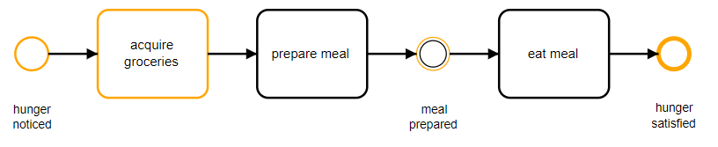
Digital narrative – modelling business processes with Camunda - 2. BPMN basic concepts
Notes:
Standard text slide (version 8) Varying the length of the paragraphs as well as using bulleted and numeric lists help with keeping the reader engaged.
Lists help to “skim” the information on the page and allow the audience to absorb a just the key information.

Slide 7
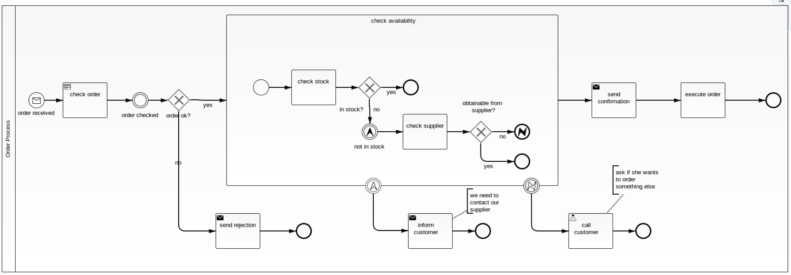
Digital narrative – modelling business processes with Camunda - 2. BPMN basic concepts
Notes:
Standard text slide (version 8) Varying the length of the paragraphs as well as using bulleted and numeric lists help with keeping the reader engaged.
Lists help to “skim” the information on the page and allow the audience to absorb a just the key information.

Slide 8
Digital narrative – modelling business processes with Camunda - 1. Why should I care about BPMN?
BPMN elements
1. Flow objects
EVENTS: circular symbols that serve as a trigger: initiating a starting point, intermediate step, or end point of a particular process. Examples: message, link, error.
ACTIVITIES: rounded rectangles, illustrating a specific task performed by a person or system. Examples: task, subprocess, call activity.
GATEWAYS: diamond-shaped symbols that map decision points. Examples: exclusive, parallel.
2. Swimlanes
Are used to organize the process. They encompass the activity for a specific role like Sales Engineers / a specific department.
3. connecting object symbols
SEQUENCE: Maps the sequential flow of objects.
ASSOCIATION: Depicts the relationship between different data and objects.
MESSAGE: Indicates a message sent between various participants in the workflow.
4. data symbols
Indicate a certain type of data or information is required for the task at hand
Notes:
Standard text slide (version 8) Varying the length of the paragraphs as well as using bulleted and numeric lists help with keeping the reader engaged.
Lists help to “skim” the information on the page and allow the audience to absorb a just the key information.

Slide 9
3
Why Camunda?
Notes:
Chapter Intro Slide (version P)
This slide should be used at the beginning of each “chapter” of your presentation (as introduced in the Agenda slide) to keep the audience aware of their place in the story and to help break things up. Change the text and chapter number accordingly. If you do not need a sub-head (the smaller text), delete it. Use different backgrounds for different chapter titles, try not to repeat a background.
Very short presentations (< ~10 slides) may not need Chapter Intro Slides.
There are multiple versions of this template with various white and black background images starting on slide 10.

Slide 10



Digital narrative – modelling business processes with Camunda - 3. Why Camunda?
Standards-based Business-IT Collaboration
Camunda defines workflows using BPMN 2.0 and DMN, providing a common language for technical and non-technical users.
Open Architecture
It provides a highly scalable platform based on open components that can be easily integrated with most common technical architectures or frameworks.
Developer-friendly Approach
The platform is easy to get started and use in your environment right away, with full public access to all docs, open APIs to integrate with just about anything, including the Spring ecosystem.
Notes:
Elements (version 2)
Elements are used to give more detail to a set of ideas, they should all relate to the same topic.
Use this page for a list of deliverables, key roles on a project, phases of a project, or any topic that can be broken down into more specific examples.
Each section should have an icon that relates to the content of that specific element, no icon should be repeated on the same page, and they should all be the same colour.
Keep the text to 1-2 sentences and aim to have about the same amount of content under each element.

Slide 11
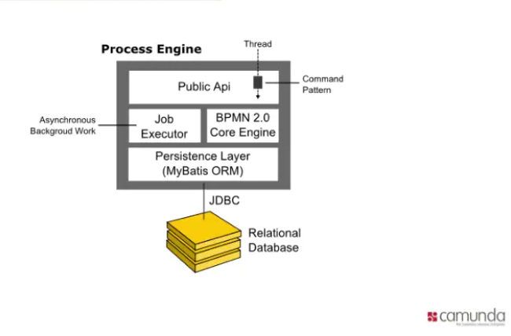
Digital narrative – modelling business processes with Camunda - 3. Why Camunda?
Notes:
Elements (version 2)
Elements are used to give more detail to a set of ideas, they should all relate to the same topic.
Use this page for a list of deliverables, key roles on a project, phases of a project, or any topic that can be broken down into more specific examples.
Each section should have an icon that relates to the content of that specific element, no icon should be repeated on the same page, and they should all be the same colour.
Keep the text to 1-2 sentences and aim to have about the same amount of content under each element.

Slide 12
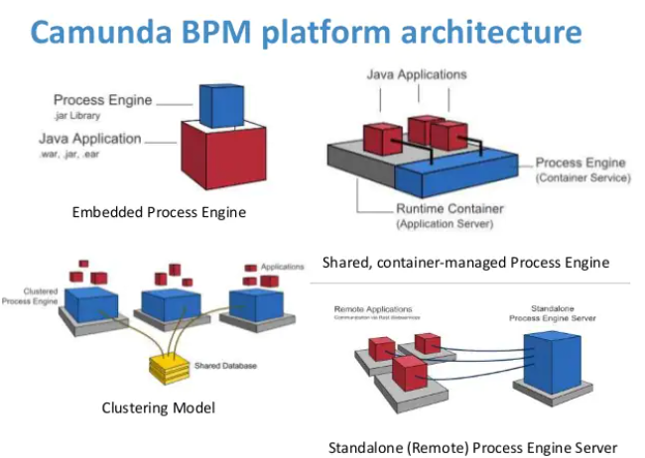
Digital narrative – modelling business processes with Camunda - 3. Why Camunda?
Notes:
Elements (version 2)
Elements are used to give more detail to a set of ideas, they should all relate to the same topic.
Use this page for a list of deliverables, key roles on a project, phases of a project, or any topic that can be broken down into more specific examples.
Each section should have an icon that relates to the content of that specific element, no icon should be repeated on the same page, and they should all be the same colour.
Keep the text to 1-2 sentences and aim to have about the same amount of content under each element.

Slide 13
4
Hands-on: Camunda with Spring Boot
Notes:
Chapter Intro Slide (version P)
This slide should be used at the beginning of each “chapter” of your presentation (as introduced in the Agenda slide) to keep the audience aware of their place in the story and to help break things up. Change the text and chapter number accordingly. If you do not need a sub-head (the smaller text), delete it. Use different backgrounds for different chapter titles, try not to repeat a background.
Very short presentations (< ~10 slides) may not need Chapter Intro Slides.
There are multiple versions of this template with various white and black background images starting on slide 10.

Slide 14
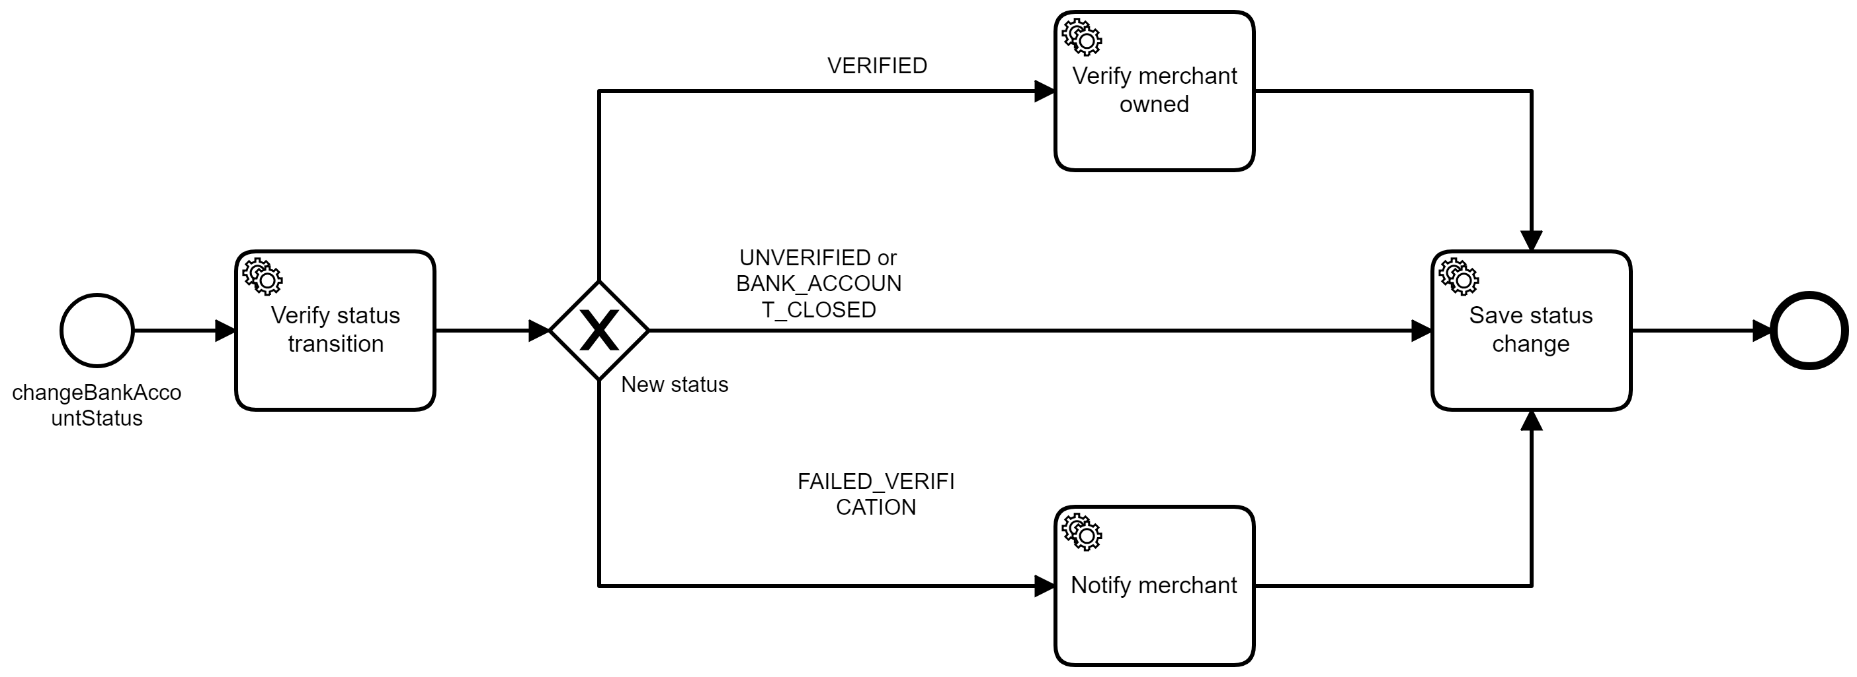
Digital narrative – modelling business processes with Camunda - 4. Hands-on: Camunda with Spring Boot
Notes:
Elements (version 2)
Elements are used to give more detail to a set of ideas, they should all relate to the same topic.
Use this page for a list of deliverables, key roles on a project, phases of a project, or any topic that can be broken down into more specific examples.
Each section should have an icon that relates to the content of that specific element, no icon should be repeated on the same page, and they should all be the same colour.
Keep the text to 1-2 sentences and aim to have about the same amount of content under each element.

Slide 15
5
Why should I care about DMN?
Notes:
Chapter Intro Slide (version P)
This slide should be used at the beginning of each “chapter” of your presentation (as introduced in the Agenda slide) to keep the audience aware of their place in the story and to help break things up. Change the text and chapter number accordingly. If you do not need a sub-head (the smaller text), delete it. Use different backgrounds for different chapter titles, try not to repeat a background.
Very short presentations (< ~10 slides) may not need Chapter Intro Slides.
There are multiple versions of this template with various white and black background images starting on slide 10.

Slide 16
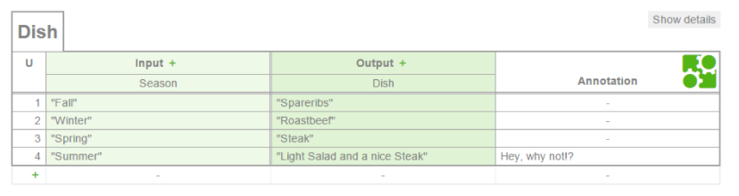
Digital narrative – modelling business processes with Camunda - 5. Why should I care about DMN?
Decision Model and Notation
1. SPECIFICATION
Global standard for simple decision-making tables.
2. Direct Execution
Business analysts can model the rules that lead to a decision in easy-to-read tables, and those tables can be executed directly by a decision engine (like Camunda). This minimizes the risk of misunderstandings between business analysts and developers, and it even allows rapid changes in production.
3. Experience
The standard does not dictate any special implementation patterns, allowing for modern and lightweight implementations.
Notes:
Standard text slide (version 8) Varying the length of the paragraphs as well as using bulleted and numeric lists help with keeping the reader engaged.
Lists help to “skim” the information on the page and allow the audience to absorb a just the key information.

Slide 17
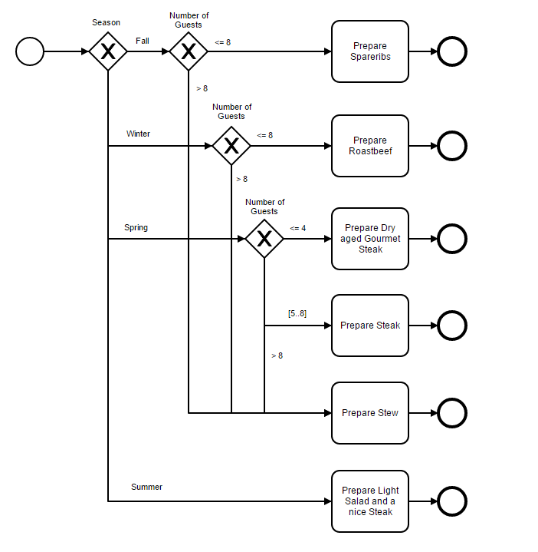
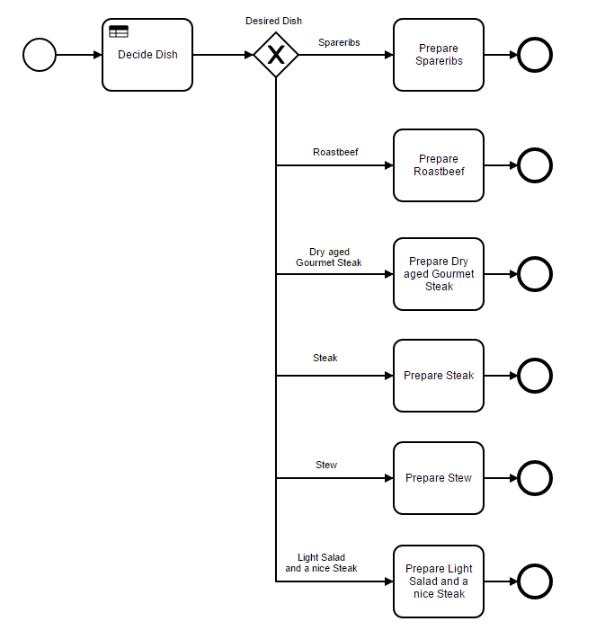
Digital narrative – modelling business processes with Camunda - 5. Why should I care about DMN?
BPMN
DMN
Notes:
Standard text slide (version 8) Varying the length of the paragraphs as well as using bulleted and numeric lists help with keeping the reader engaged.
Lists help to “skim” the information on the page and allow the audience to absorb a just the key information.

Slide 18
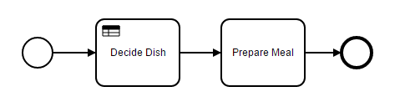
Digital narrative – modelling business processes with Camunda - 5. Why should I care about DMN?
DMN
#DevWeek(DecisionTable)
Notes:
Standard text slide (version 8) Varying the length of the paragraphs as well as using bulleted and numeric lists help with keeping the reader engaged.
Lists help to “skim” the information on the page and allow the audience to absorb a just the key information.

Slide 19
6
Further reading
Notes:
Chapter Intro Slide (version P)
This slide should be used at the beginning of each “chapter” of your presentation (as introduced in the Agenda slide) to keep the audience aware of their place in the story and to help break things up. Change the text and chapter number accordingly. If you do not need a sub-head (the smaller text), delete it. Use different backgrounds for different chapter titles, try not to repeat a background.
Very short presentations (< ~10 slides) may not need Chapter Intro Slides.
There are multiple versions of this template with various white and black background images starting on slide 10.

Slide 20
Digital narrative – modelling business processes with Camunda - 6. Further reading
Further reading
1. https://camunda.com/
2. https://camunda.com/developers/
3. https://camunda.com/best-practices/
4. https://docs.camunda.org/manual/7.12/user-guide/
5. https://camunda.com/products/camunda-platform/modeler/
Resources used in the presentation
https://github.com/danielaciuperca/camunda
Notes:
Standard text slide (version 1)
Use standard text slides as little as possible. They can be used for an introduction to a presentation, summary of work, detailed legal information.
All presentations should be a mix of text-heavy pages and visual pages.
In a presentation, choose between 1, 2, or 3 column text pages to be consistent within the document.

